Slide 1

Bank Marketing Campaign
Virtual Internship
11-July-2022

Slide 2
Team member’s details
Group Name: The Greek Scientist
Name: Nikolaos Sintoris
Email: nikolaossintoris@gmail.com
Country: Greece
College/Company: Data Glacier
Specialization: Data Science
GitHub Repo Link: https://github.com/NikolaosSintoris/Data-Glacier-Virtual-Internship/tree/main/Week%2011

Slide 3
Profit Analysis
Problem Description
ABC Bank wants to sell its term deposit product to customers and before launching the product they want to develop a model which help them in understanding whether a particular customer will buy their product or not (based on customer's past interaction with bank or other Financial Institution).

Slide 4
Profit Analysis
Data Understanding
Data Information: The data is related with direct marketing campaigns of a Portuguese banking institution. The marketing campaigns were based on phone calls. Often, more than one contact to the same client was required, in order to access if the product (bank term deposit) would be (or not) subscribed.
Summary of the data: The bank-additional-ful.csv file, consists of 41188 observations (rows) and 21 attributes (columns). The size of the file is 6.6 MB.
Attributes: Age, job, marital, education, default, housing, loan, contact, month, day of week, duration, campaign, pdays, previous, poutcome, emp.var.state, cons.price.idx, cons.conf.idx, euribor3m, nr.employed as well as the output variable y (whether the client subscribed a term deposit).

Slide 5
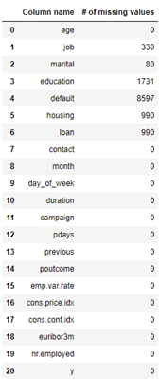
Profit Analysis
Missing Values
In our data, missing values is the value "unknown" in the categorical attributes, so job has 330 missing values, marital has 1731, default has 8597, housing has 990 and loan has 990.as they are shown in the screenshot below:
For the missing values we are going to use 2 techniques. When the most frequent word has by far more data points we, are going to replace the missing values with the most frequent one. Otherwise we are going to replace the missing values with a random value. So, for the job, education and housing attributes we are going to use the second technique and the first technique for the other attributes.

Slide 6
Profit Analysis
Exploratory Data Analysis
I performed Exploratory Data Analysis on the data. First I examined the pearson correlation coefficient between the attributes and the result was that there was no correlation between them. So I examined the relationship between the output variable (“y”) and some of the rest attributes.

Slide 7
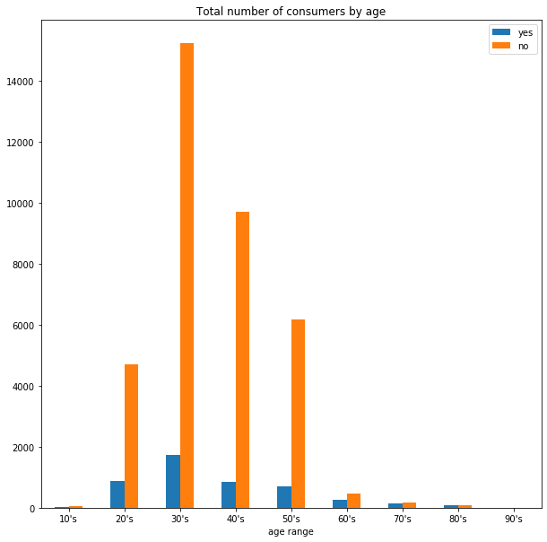
Total Number of Consumers by Age
In the graph we can see that for the ages 20 to 60, there is a significant difference between those who applied and those who did not.
We also observe that at every age, those who did not apply far outnumbered those who did.

Slide 8
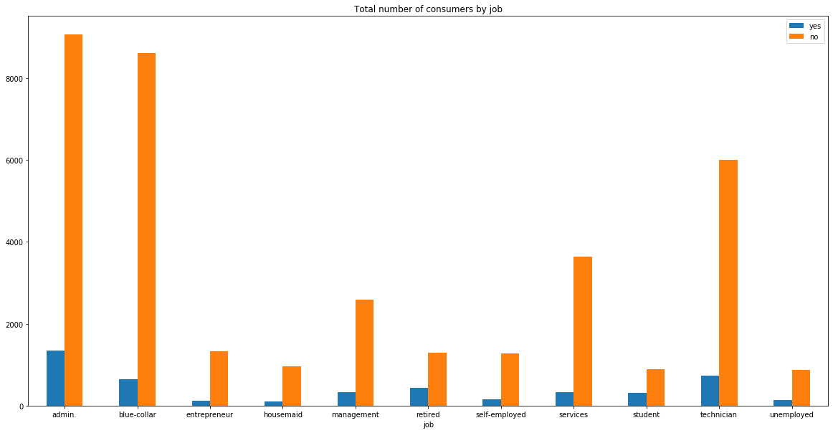
Total Number of Consumers by Job
In the graph we can see that the jobs admin, blu-collar and technician have the highest number of consumers.
We also observe that at every job, those who did not apply far outnumbered those who did.

Slide 9
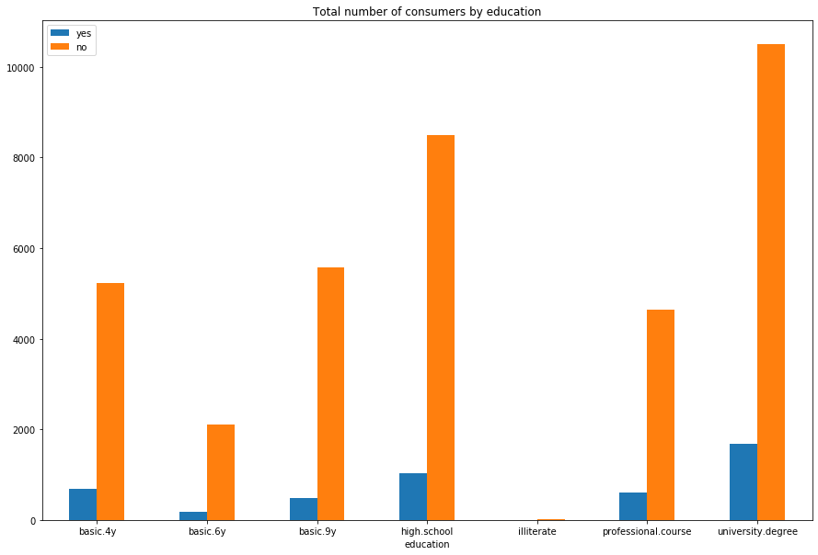
Total Number of Consumers by Education
In the graph we can see that university degree has the highest number of consumers in both categories.
We also observe that at every education, those who did not apply far outnumbered those who did.

Slide 10
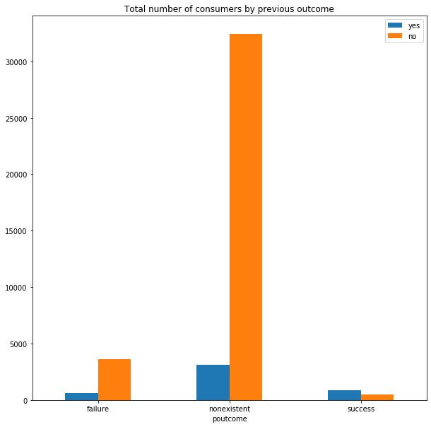
Total Number of Consumers by Previous Outcome
In the graph we can see that nonexistent poutcome has the highest number of consumers in both categories.
We also observe that those who have previous campaign and it was successful they subscribe in a term deposit.

Slide 11
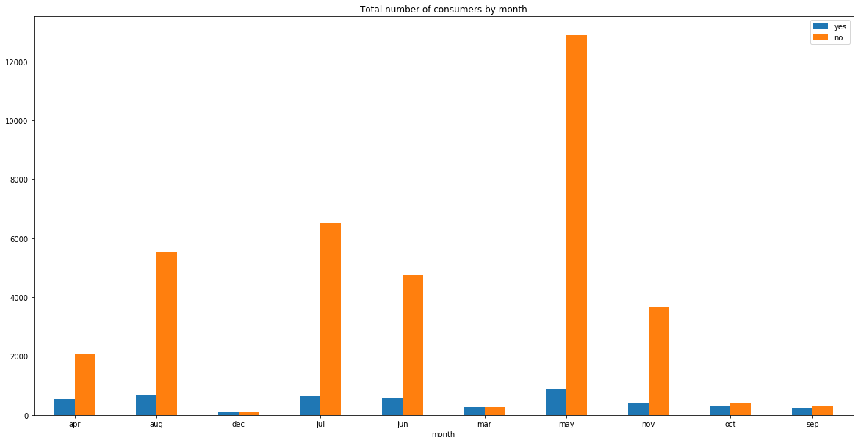
Total Number of Consumers by Month
In the graph we can see in May we have the most contacts in both cases..
Generally, months in summer have the most contacts in both cases.
We also observe that December, March, October and September we have small differences between those 2 cases.

Slide 12
Recommendations
Based on the above the EDA showed that age, duration, month and poutcome may have important role for the bank to sell his term deposit to the customers.
The recommended models for this data set are:
Logistic Regression
Random Forest Classifier
Gradient Boosting Classifier

Slide 13
Thank You

